Slide 1


Slide 2
Introduction to Healthcare
Prepared by: Shailja Kaushal

Slide 3
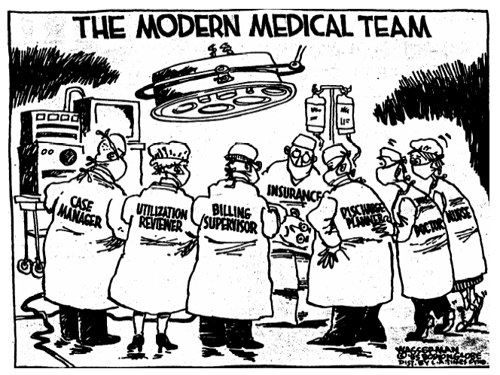
Introduction

Slide 4
Agenda
1
The Healthcare Landscape
2
Managed Care Plans
3
Medicare
4
Medicaid
5
Legislation and reforms
6
PBM
Notes:
4

Slide 5
Healthcare – 5P’s
Provider
Patient
Participants
Payer/PBM
Policy
Makers
Notes:
PBM – link to next slide – HS business

Slide 6
Healthcare Landscape
PROVIDERS
REGULATORS
PAYERS
Policy Makers
Diagnostic
Services
Employers
Licenses
Applications & Approvals
Regulations
Licensed Health
Professionals
Health Plans
Patient
Coverage
Care
Premiums
Health Delivery
systems/
Facilities
Global Insurers
Orders
Products
Nursing &
Home Health
Participants
Carve Outs
(PBMs Others)
Pharmacies
Medical
Products
ISV’s
Contract
Services

Slide 7
1. The 1st P = Provider
Healthcare Provider
Hospitals
Nursing
&
Residential Care
Ambulatory services

Slide 8

1a. Classification of Hospitals
On the basis of ownership
Public
Private (for profit, not-for-profit)
On the basis of service
General
Specialist (Tertiary)
Teaching
On the basis of care delivered
Acute
Chronic

Slide 9
1b. Nursing & Residential Care
Nursing & Residential care
Nursing Care
Mental Care
Elderly Care
Nursing facilities provide inpatient nursing, rehabilitation, and health-related personal care to those who need continuous nursing care, but do not require hospital services.
Residential care facilities provide around-the-clock social and personal care to children, the elderly, and others who have limited ability to care for themselves.
Average length of the stay is several weeks.
Nursing & Residential care facilities are also known as Long Term Care (LTC) or Skilled Nursing Facilities (SNFs).

Slide 10
1c. Ambulatory Care Services
Ambulatory Care Services
Physician Office
Out Patient
Laboratories
Home Health
Physician Office Physicians and surgeons practice privately or in groups of practitioners who have the same or different specialties.
Out Patient are the hospital OPDs where a patient avails the medical services within business hours and doesn't stay overnight.
Home Health Skilled nursing or medical care is sometimes provided in the home, under a physician’s supervision. Rehabilitation services.
Laboratories Medical and diagnostic laboratories provide analytic or diagnostic services to the medical profession or directly to patients following a physician’s prescription.

Slide 11

1d. Some Other Providers
Integrated Delivery Networks
IDNs include many types of associations across the continuum of care and one network may include a short- and long-term hospital, HMO, PPO, Home Health agency, and hospice services, for example.
Physician Group Practices
Public Health Agencies
Community Health Programs

Slide 12
1i. Roles in Provider Space
Physicians
Primary Care Physicians (PCP), Family Medicine
Specialists: Internal Medicine, Orthopedic Surgeon, Psychiatrist, etc.
Midlevel Practitioners
Physician Assistants
Advanced Practice Nurses: Nurse Practitioners (NPs), Certified Nurse Midwives (CNMs), Certified Registered Nurse Anesthetists (CRNAs)
Other Practitioners
Pharmacists
Informatics Professionals
Emergency Room Doctors, Diagnosticians
X-Ray Technician
Nurses: LPNs, RNs
Dietician

Slide 13



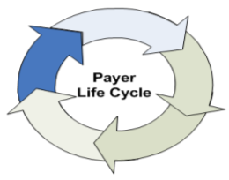



2. The 2nd P = Payer
Design and Track Products
Billing and Accounting
Manage Provider Network
Operations Management
Customer Management
Manage Costs
Notes:
Design and Track Products: Design and planning Team is involved in the in this stage and they design and track various Benefits plans/products offered by the organization and compliance to legislation.
2. Manage Provider Network: In this stage the payer organization manages the provider network specified under the plan by way of designing and developing compensation for providers, verification and validation of the provider credentials, payment to the providers on the basis of their performance and manage the provider data.
3. Customer management: In this stage the payer organization manages the customer in terms of member registration/enrollment (under which plan the customer has registered, monthly premiums determination), customer grievance & appeals, COBRA Administration (for the members who have lost their existing job at the time of registration), Benefits administration and eligibility administration to track the eligibility of the customer for the plan he/she has applied for.
4. Manage Costs: This stage comes after the providers and the customers have been registered. This stage starts once the customers start visiting the providers for which the payer organization has to pay, hence the focus in this stage is to manage costs by managing utilization, discharge planning (to manage the discharge of a customer in inpatient type of setting as overstay will cost the payer organization a lot), authorization and disease management (by being proactive and to prevent certain diseases from happening by taking preventive measures as treatment would cost much more than prevention).
5. Operations Management : In this stage the payer organization manages its various operations such as claims administration/processing, electronic data interchange between the payer organization and the provider in case of a claim is made by the provider, underwriting and rating to asses risk associated with a customer and hence to decide on the monthly premium, accreditation of the payer organization from bodies like NCQA (National Accreditation for Quality Assurance) and the Sales and Marketing functions in order to retain and acquire new customers.
6. Billing and Accounts: This function refers to the activities such as monthly premium billing , capitation, electronic fund transfer and journaling which is nothing but archiving the transactions and other information for future reference.

Slide 14
Payer Classification
Payers
Private
Public (Gov’t)
MCOs
PBMs
Employers
Medicare
Medicaid
VA/DOD
HMOs
PPOs
POS
Fee-for-service – pays for services as rendered, with patient co-pay or deductible
Managed care – payer influences services consumed and patient choice in an effort to limit costs

Slide 15

Health Maintenance Organization (HMO)
An insurance plan that pays for healthcare services provided by a specific group of hospitals and doctors. Patients must be referred to specialists and specialty services by their primary care physician
Comprised of hospitals, doctors and allied medical personnel who have contracted to provide healthcare to members in return for a pre-paid monthly charge
Preferred Provider Organization (PPO)
An insurance plan that pays for healthcare services provided by a specific group of hospitals and doctors. Patients are free to make appointments with any healthcare providers within the network without approval from their primary care physician (also, not necessary to designate a single doctor as a policyholder's primary care physician)
Also provides with coverage on out-of-network doctors as well
Point of Service (POS)
Mixture of the HMO and PPO. Like an HMO, a person picks a primary care physician but as in a PPO, he can seek help from any medical professional in or out-of-network, he will still be covered
Indemnity/FFS
Traditional Plans

Slide 16
The 3rd P = Participants
Pharmacies
Independent Software Vendors ( ISV’s )
Contract Services
Medical Products
Prepare and dispense drugs.
Outpatient Pharmacies, Drug stores.
Under Administration of one/ more pharmacists.
Take care of the end to end IT Requirement of provider space. (Hardware & Software)
Highly fragmented market with small & big players.
They are players which provides services like transportation (Ambulance, Helicopter)
They are the players which supplies the provider space with right kind of technical devices & equipments.

Slide 17

The 4th P = Policy Maker “Government Regulation”
Employee Retirement and Income Security Act (ERISA) 1974 – regulates pension and health plans provided to employees
Consolidated Omnibus Budget Reconciliation Act (COBRA) – continuation of insurance
Health Insurance Portability and Accountability Act (HIPAA) – protection for preexisting medical conditions, medical discrimination, and privacy of PHI
Certificate of Need (CON) – state level. Can we build a hospital here? 36 states have some form of CON program, law, or agency.

Slide 18
4a. HIPAA
Ensures that those who maintain or transmit health information maintain reasonable and appropriate administrative, technical, and physical safeguards.
To ensure the integrity and confidentiality of the information.
To protect against any reasonably anticipated threats or hazards to the security or integrity of the information; and unauthorized uses or disclosures of the information.
Notes:
HIPAA requires the protection of health information against any reasonably anticipated threats or hazards to the security or integrity of the information or its unauthorized use or disclosure. This regulation requires that [the Agency] and the health care industry have adequate security in place to protect health information. This law has a far reaching impact on information systems, health care partners, as well as private health systems.
Business survives on having accurate confidential records. It is [the Agency’s] promise to the beneficiary that we keep this record accurate, safe, and confidential. Privacy and security go hand in hand. We need security in order to ensure privacy and confidentiality.

Slide 19
4b. Non-Government Oversight
Joint Council on the Accreditation of Healthcare Organizations (JCAHO) - A voluntary accreditor for hospitals
National Committee for Quality Assurance (NCQA) - accredits managed care organizations
Peer Review Organization (PRO) - reviews Medicare patient records

Slide 20
The Complete Picture
Marketing
Reimburse
Pharma/Biotech/ Medical Device
Payers
Providers
Hospitals
Physician practices/ physician groups
Private: MCO (Managed Care Organizations aka Insurance)
PPO
HMO
Public:
CMS (Centers for Medicare and Medicaid Services)
Supply drugs/
device
Reimburse
Fixed $ Per Member Per Month (PMPM)
Provide service
Employers
Retail
Provide drugs/device
Employ
Consumers / Patient

Slide 21
Agenda
1
The Healthcare Landscape
2
Managed Care Plans
3
Medicare
4
Medicaid
5
Legislation and reforms
6
PBM
Notes:
21

Slide 22
Deductible, Co-Pay and Co-Insurance
Deductible : The amount that the policy-holder must pay out-of-pocket before the health plan pays its share.
Example : A policy-holder might have to pay a $500 deductible per year, before any of their health care is covered by the health plan. It may take several doctor's visits or prescription refills before the policy-holder reaches the deductible and the health plan starts to pay for care.
Copayment : The amount that the policy-holder must pay out of pocket before the health plan pays for a particular visit or service.
Example : A policy-holder might pay a $45 copayment for a doctor's visit, or to obtain a prescription. A copayment must be paid each time a particular service is obtained.
Coinsurance : Instead of paying a fixed amount up front (a copayment), the policy-holder must pay a percentage of the total cost.
Example : The member might have to pay 20% of the cost of a surgery, while the health plan pays the other 80%. The policy-holder can end up owing very little, or a significant amount, depending on the actual costs of the services they obtain.
Time for hand-out on health insurance policy

Slide 23
Managed Care Plans
Health Maintenance Organization (HMO):-
An insurance plan that pays for healthcare services provided by a specific group of hospitals and doctors. Patients must be referred to specialists and specialty services by their primary care physician
Preferred Provider Organization (PPO):-
An insurance plan that pays for healthcare services provided by a specific group of hospitals and doctors. Patients are free to make appointments with any healthcare providers within the network without approval from their primary care physician (also, not necessary to designate a single doctor as a policyholder's primary care physician)
Exclusive Provider Organizations (EPOs):-
A more restrictive type of preferred provider organization plan under which employees must use providers from the specified network of physicians and hospitals to receive coverage; there is no coverage for care received from a non-network provider except in an emergency situation.
Point of Service (POS) – hybrid of PPO and FFS:-
A POS plan is an "HMO/PPO" hybrid; Services received outside of the network are usually reimbursed in a manner similar to conventional indemnity plans (e.g., provider reimbursement based on a fee schedule or usual, customary and reasonable charges).
Indemnity / Fee For Service (FFS):-
Fee For Service plans are sometimes called “Indemnity Plans.” The plan “indemnifies” you from health expenses — which means it pays for those expenses. There are no “provider networks” or “tiers of coverage.” You see any doctor you choose, and your plan pays the bill.
Notes:
Exclusive provider organization (EPO) plan - A more restrictive type of preferred
provider organization plan under which employees must use providers from the
specified network of physicians and hospitals to receive coverage; there is no
coverage for care received from a non-network provider except in an emergency
situation.
Point-of-service (POS) plan - A POS plan is an "HMO/PPO" hybrid; sometimes
referred to as an "open-ended" HMO when offered by an HMO. POS plans resemble
HMOs for in-network services. Services received outside of the network are usually
reimbursed in a manner similar to conventional indemnity plans (e.g., provider
reimbursement based on a fee schedule or usual, customary and reasonable charges).
Indemnity of Fee For Service plans are the oldest kind of health insurance coverage. They’re also usually the most expensive.
Fee For Service plans are sometimes called “Indemnity Plans.” The plan “indemnifies” you from health expenses — which means it pays for those expenses. There are no “provider networks” or “tiers of coverage.” You see any doctor you choose, and your plan pays the bill.
Advantages of FFS Plans
Despite their increased cost, FFS plans do offer advantages over managed care plans.
No pre-approval for care. Some health insurance plans require you to get approval for medical care before they’ll cover it. In an FFS plan, you won’t need to get pre-approval from your physician or from your insurance company. No provider networks. Most health plans have networks of doctors and hospitals, and may require you to use these networks. FFS plans don’t cover care from specific providers — they cover specific medical services. You can receive care any doctor you choose, and your FFS plan will cover it.
Disadvantages of FFS Plans
FFS plans have their drawbacks, too:
Limited coverage for routine care. Many FFS plans are geared toward paying expensive medical bills, not covering regular care. If you’re more concerned with having coverage for routine and preventive care, an FFS plan may not be a smart choice. High premiums and deductibles. FFS plans are very flexible, but that flexibility comes at a price. FFS plans are among the most expensive plans on the market.

Slide 24
Agenda
1
The Healthcare Landscape
2
Managed Care Plans
3
Medicare
4
Medicaid
5
Legislation and reforms
6
PBM
Notes:
24

Slide 25
Medicare
US Government sponsored program to provide health and economic security to seniors (more than 65 years of age)
Expanded in 1972 to cover younger beneficiaries with permanent disabilities
Covers individuals without regard to income or medical history
Has four parts: A, B, C, and D
Part A – Hospital and skilled nursing care
Part B – Physician and outpatient hospital care
Part C – HMOs/Medicare Advantage
Part D – Outpatient prescription drug coverage
Discussion: Who pays for Medicare?

Slide 26
Agenda
1
The Healthcare Landscape
2
Managed Care Plans
3
Medicare
4
Medicaid
5
Legislation and reforms
6
PBM
Notes:
26

Slide 27
Medicaid
Available only to low-income individuals and families who fit into an eligibility group
Medicaid provides health coverage for
39 million children and parents in low-income families, medical
long-term care coverage for 8 million individuals with disabilities
long-term care for over 6 million low-income Medicare beneficiaries.

Slide 28
Agenda
1
The Healthcare Landscape
2
Managed Care Plans
3
Medicare
4
Medicaid
5
Legislation and reforms
6
PBM
Notes:
28

Slide 29
COBRA
Applies to job-based plans sponsored by employers with > 20 employees
Temporary continuation of coverage after qualifying event
Loss of employment: 18 months
Change in family/dependent status: 36 months
Disability: 29 months
Premium contribution not required from the employer
Can be very costly for individuals to afford
Notes:
Another federal law, COBRA, was adopted in 1985 and applies to job-based plans with 20 or more employees.
Allows people to temporarily remain in job-based group health plan, even after they lose job/dependent status
COBRA protection is important. Remember group coverage cannot discriminate based on health status but individual coverage often can. Therefore, if you’re sick or pregnant as you’re about to lose your job, COBRA protections can be a lifeline source of coverage.
However, COBRA is an incremental protection. It protects the availability of coverage, but not the affordability of coverage. Employer premium contribution is not required under COBRA. So only about 1 in 5 people who are eligible for COBRA coverage end up taking it.
Also, COBRA is a continuation right. If you lose coverage because your employer goes bankrupt and closes the health plan, there’s no plan to continue in, so COBRA won’t help.
Finally, COBRA doesn’t apply to employers with fewer than 20 workers. However, almost 40 states have adopted state continuation laws (or mini COBRAs) that offer similar protections for people leaving health plans sponsored by employers with fewer than 20 employees. These state continuation laws apply to insurers who sell coverage to fully insured employers.

Slide 30
HIPAA Standardization
A "code set" is any set of codes used for encoding data elements, such as tables of terms, medical concepts, medical diagnosis codes, or medical procedure codes.
Identifiers are HIPAA standards that create a uniform and centralized way to designate an employer, provider, health plan or patient in electronic transactions.
Transactions are electronics exchanges involving the transfer of healthcare information between two parties for specific purposes—such as a healthcare provider submitting medical claims to a health plan for payment.
HIPAA adopted certain standard transactions for electronic data interchange (EDI) for the transmission of healthcare data.
Privacy: It encompasses legislation to ensure that Protected Health Information (PHI) of an individual is protected. The information transmitted between the various entities is protected
Security: All forms of technical and physical safeguards needs to be provided to ensure data security

Slide 31
Meaningful Use Incentive Program
Stage 1 (2011-2012)
Data Capture & Sharing
Electronically capturing health information in a standardized format
Stage 2 (2014)
Advanced Clinical processes
More rigorous health information exchange (HIE)
Stage 3 (2016)
Improved Outcomes
Improving quality, safety, and efficiency, leading to improved health outcomes
Using that information to track key clinical conditions
Communicating that information for care coordination processes
Initiating the reporting of clinical quality measures and public health information
Using information to engage patients and their families in their care
Increased requirements for e-prescribing and incorporating lab results
Electronic transmission of patient care summaries across multiple settings
More patient-controlled data
Decision support for national high-priority conditions
Patient access to self-management tools
Access to comprehensive patient data through patient-centered HIE
Improving population health
Incentive program aimed at use certified EHR technology for Medicare & Medicaid in a meaningful manner. It’s achieved by meeting set of core and menu objectives in three stages over five years:
Objectives of this program:
Improve quality, safety, efficiency, and reduce health disparities
Engage patients and family
Improve care coordination, and population and public health
Maintain privacy and security of patient health information
It is hoped that the “Meaningful Use” compliance will result in:
Better clinical outcomes
Improved population health outcomes
Increased transparency and efficiency
Empowered individuals
More robust research data on health systems

Slide 32
ICD (International Classification of Diseases)
A healthcare classification system to codify diseases and a wide variety of signs, symptoms, abnormal findings, external causes of injury or disease and treatment procedures. Published by WHO. CMS controls any modification or additions in the US.
Used for morbidity and mortality statistics, reimbursement systems, and automated decision support in healthcare
What does that mean to us patients? Each diagnosis has a code that goes with it. Every medical professional in the US and much of the world will understand the diagnosis the same way. So, for example, if I am diagnosed with GERD (acid reflux), it will be given the code 530.81. If I travel across the country and need to see a doctor for my heartburn, he will also put a 530.81 on my record. The 530.81 is the ICD classification.
If the diagnosis is for something acute, something that goes away with treatment like a rash or the flu, then the ICD code will be less important to us. However, if we are diagnosed with a chronic or lifelong problem, like heart disease or diabetes, then the ICD code will follow us for most of our medical care, and will help our healthcare providers make determinations about our care. As Electronic Health Records (EHRs) are implemented, these codes will affect our care more and more.

Slide 33
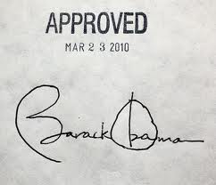
Affordable Care Act- “OBAMACARE”
2 federal acts enacted in 2010:
Patient Protection and Affordable Care Act (PPACA - aka, Affordable Care Act or simply, Obamacare)
Health Care and Education Reconciliation Act - amended PPACA and became law on March 30, 2010
4 key components:
Increased health insurance coverage
Healthcare Delivery and Payment Reforms
Insurance Market Reforms and Regulations
Preventive aspect of healthcare
Headstrong: A Genpact company
Notes:
33

Slide 34
Agenda
1
The Healthcare Landscape
2
Managed Care Plans
3
Medicare
4
Medicaid
5
Legislation and reforms
6
PBM
Notes:
34

Slide 35
What is a PBM ?
Emerged in late 1970s .Adjudicate 80% of all prescriptions (~4 billion annually) processed today.
Role - Initially it was to help employers and insurance plans to manage claims administration and cut costs. Now, PBMs evolved to a complex administrator, negotiator and advisor from third party claims processor.
Responsibility - Primary responsibility is to process and pay prescription drug claims.
Clients - Insurance companies, retail drugstores, employers, unions, Medicare and Medicaid. Some are subsidiaries of insurance plans or retail drugstores, while others are independently owned.

Slide 36
Why PBM ?
The spending on prescriptions has increased at a faster rate than overall health care spending.
Why is this?
Expanded use of Prescription drugs
New Drugs
Drug Therapies have replaced some inpatient care
An aging population which means more users and more prescriptions per user
More direct-to-consumer advertising of drugs
Price inflation

Slide 37
Major Pharmacy Benefit Managers in the U.S.
Top three handle 50% of outpatient prescription volume
CVS/Caremark Rx
Medco Health Solutions
Express Scripts
Others
Wellpoint Pharmacy Management
PharmaCare
MedImpact

Slide 38
Who PBMs Serve
Health plan organizations
Corporate health plans
Insurance groups
Blue Cross Blue Shield plans
Employers
Government entities (federal, state, local)
Taft Hartley funds/unions
Third party administrators (TPAs)
Discount card/cash card programs

Slide 39
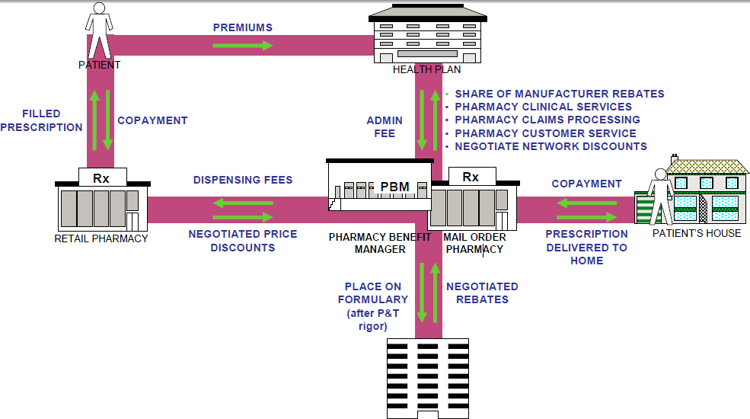
PBM – How it Works
Discuss how a prescription is filled in the US.
Notes:
P&T = pharmacy and therapeutics

Slide 40
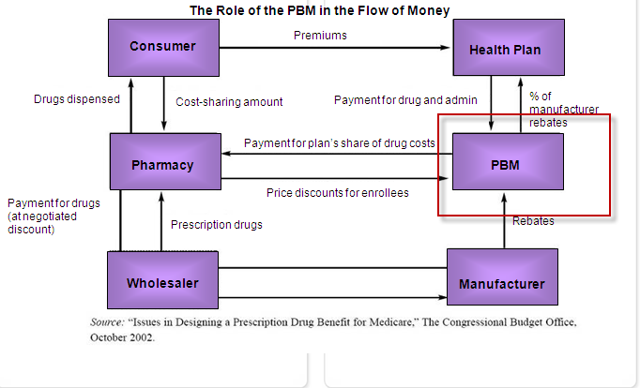
Where it Fits in the Health Insurance system ?

Slide 41
What a PBM Does
Claim Administration and Benefit administration
Pharmacy Network
Formulary
Rebates and Discounts
DUR (Drug Utilization Review)

Slide 42
Top 10 Tasks of PBMs
Contract directly with HC providers to provide services
Communicate policies between providers, employers and patients
Reports to employers (or other plan sponsors)
Verification of eligibility
Maintain formularies or PDLs
DUR (drug utilization review)
Claims processing
Reimbursement of providers and patients
Strategies for cost/utilization controls
TQM (total quality management)

Slide 43
Most Common services PBMs offer
Mail Service
Specialty Pharmacy
Prior Authorization
Disease Management

Slide 44
Shailja.kaushal@genpact.com

